Slide 1




1604C054 – Hybrid Mobile Programming
Ionic UI Components 1 - Layouting
WEEK 05 Informatics Engineering
Universitas Surabaya
Informatics Engineering | Universitas Surabaya
Notes:
Cover Half
Gambar vector bisa didownload di: https://scale.flexiple.com/illustrations/
Jika ingin foto free royalty bisa download di: https://pixabay.com/photos/

Slide 2
Outline
1
2
Components for Layouting
Route with Parameter
Informatics Engineering | Universitas Surabaya

Slide 3
Components for Layouting
Informatics Engineering | Universitas Surabaya

Slide 4
ion-header & ion-footer
Header is a root component of a page that aligns itself to the top of the page. It is recommended to be used as a wrapper for one or more ion-toolbar, but it can be used to wrap any element.
Footer is a root component of a page that aligns itself to the bottom of the page. It is recommended to be used as a wrapper for one or more ion-toolbar, but it can be used to wrap any element.
Informatics Engineering | Universitas Surabaya

Slide 5
ion-toolbar
Toolbars are generally positioned above or below content and provide content and actions for the current screen.
Toolbars can contain several different components including titles, buttons, icons, back buttons, menu buttons, searchbars, segments, progress bars, and more.
It is recommended to put a toolbar inside of a ion-header or ion-footer for proper positioning. When a toolbar is placed in a header it will appear fixed at the top of the content. When it is placed in a footer it will appear fixed at the bottom. Fullscreen content will scroll behind a toolbar in a header or footer. An ion-title component usually used to display text inside of the toolbar.
Informatics Engineering | Universitas Surabaya

Slide 6
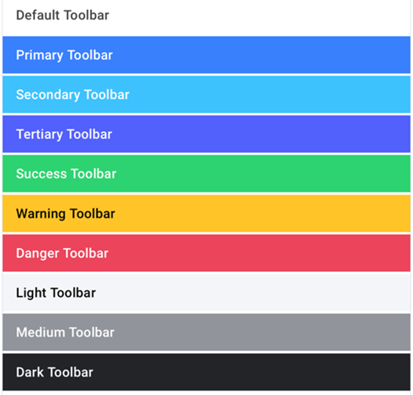
ion-toolbar (2)
Frequently used property:
color
The color to use from your application's color palette.
"danger" ｜ "dark" ｜ "light" ｜ "medium" ｜ "primary" ｜ "secondary" ｜ "success" ｜ "tertiary" ｜ "warning" ｜ string ｜ undefined
mode
The mode determines which platform styles to use.
"ios" ｜ "md"
Informatics Engineering | Universitas Surabaya

Slide 7
ion-content
The content component provides an easy to use content area with some useful methods to control the scrollable area. There should only be one content in a single view.
Content, along with many other Ionic components, can be customized to modify its padding, margin, and more using the global styles or by individually styling.
Content can be the only top-level component in a page, or it can be used alongside a header, footer, or both. When used with a header or footer, it will adjust its size to fill the remaining height.
Informatics Engineering | Universitas Surabaya

Slide 8
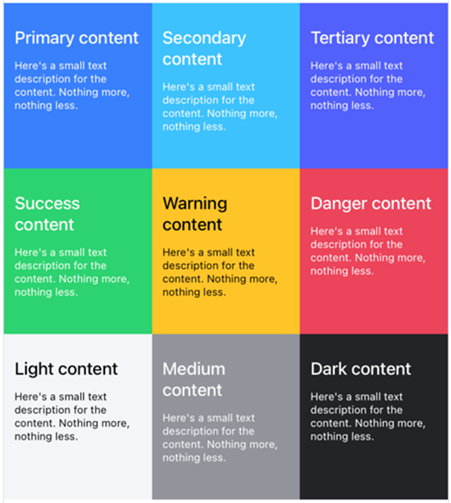
ion-content (2)
Frequently used property:
color
The color to use from your application's color palette.
"danger" ｜ "dark" ｜ "light" ｜ "medium" ｜ "primary" ｜ "secondary" ｜ "success" ｜ "tertiary" ｜ "warning" ｜ string ｜ undefined
Informatics Engineering | Universitas Surabaya

Slide 9
ion-list
ion-list are made up of multiple rows of ion-item which can contain text, buttons, toggles, icons, thumbnails, and much more. Lists generally contain items with similar data content, such as images and text.
Frequently used property:
inset
If true, the list will have margin around it and rounded corners.
lines
How the bottom border should be displayed on all items. "full" ｜ "inset" ｜ "none" ｜ undefined
ion-list-header
List headers are block elements that are used to describe the contents of a list
Informatics Engineering | Universitas Surabaya

Slide 10
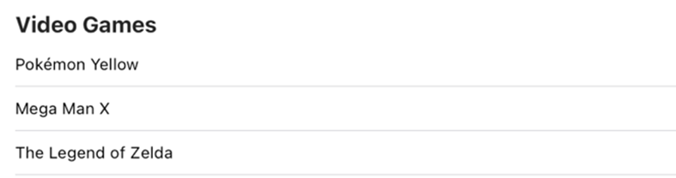
ion-list (2)
<ion-list>
<ion-list-header>
<ion-label>Video Games</ion-label>
</ion-list-header>
<ion-item>
<ion-label>Pokémon Yellow</ion-label>
</ion-item>
<ion-item>
<ion-label>Mega Man X</ion-label>
</ion-item>
<ion-item>
<ion-label>The Legend of Zelda</ion-label>
</ion-item>
</ion-list>
Informatics Engineering | Universitas Surabaya

Slide 11
ion-accordion
Accordions provide collapsible sections in your content to reduce vertical space while providing a way of organizing and grouping information.
All ion-accordion components should be grouped inside ion-accordion-group components.
The header slot is used as the toggle that will expand or collapse your accordion. We recommend you use an ion-item here to take advantage of the accessibility and theming functionalities.
The content slot is used as the part of the accordion that is revealed or hidden depending on the state of your accordion. You can place anything here except ion-content.
Informatics Engineering | Universitas Surabaya

Slide 12
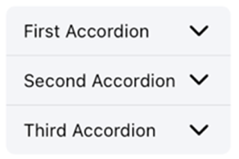
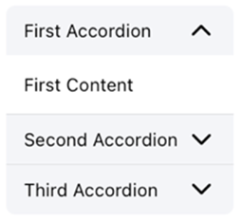
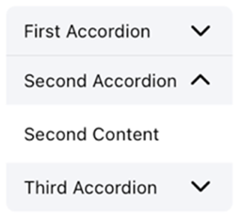
ion-accordion(2)
<ion-accordion-group expand="inset">
<ion-accordion value="first">
<ion-item slot="header" color="light">
<ion-label>First Accordion</ion-label>
</ion-item>
<div class="ion-padding" slot="content">First Content</div>
</ion-accordion>
<ion-accordion value="second">
<ion-item slot="header" color="light">
<ion-label>Second Accordion</ion-label>
</ion-item>
<div class="ion-padding" slot="content">Second Content</div>
</ion-accordion>
<ion-accordion value="third">
<ion-item slot="header" color="light">
<ion-label>Third Accordion</ion-label>
</ion-item>
<div class="ion-padding" slot="content">Third Content</div>
</ion-accordion>
</ion-accordion-group>
Informatics Engineering | Universitas Surabaya

Slide 13
Exercise 1 (max 20 minutes)
Create Pasta page and provide link in the drawer to open it. Pasta screen shows several pasta in an accordion style. The pasta name shown in the accordion title and the photo, description, and price hiding in the accordion content.
Use ion-list and ion-item for arranging this photo, description, and price.
Use array in next slide for the data.. or you can create it by yourself
Informatics Engineering | Universitas Surabaya

Slide 14
Exercise 1 (2)
Data from : https://www.unos.com/menus/pasta.php
pastas = [
{
name: "SHRIMP SCAMPI",
url: "https://www.unos.com/images/menus/pasta/Pasta_ShrimpScampi_8-20_300.jpg",
description: "Shrimp sautéed with garlic, diced tomatoes and basil in a white wine sauce on vermicelli with parmesan",
price: 42000
},
{
name: "CHICKEN SPINOCCOLI",
url: "https://www.unos.com/images/menus/pasta/Pasta_ChickenSpinoccoli_8-20_300.jpg",
description: "Our housemade chicken roulade filled with mozzarella, feta, broccoli, spinach, tomatoes, garlic and basil, on top of penne tossed with sautéed pesto, alfredo and our chunky vine-ripened tomato sauce.",
price: 35000,
},
{
name: "CHICKEN & BROCCOLI ALFREDO",
url: "https://www.unos.com/images/menus/whatsnew/CHICKEN_BROCCOLI_ALFREDO.png",
description: "Cavatappi, chicken and broccoli tossed in alfredo sauce topped with parmesan cheese.",
price: 38000,
}, {
name: "DEEP DISH MAC & CHEESE",
url: "https://www.unos.com/images/menus/pasta/Pasta_MacCheese_8-20_300.jpg",
description: "Ooey, gooey, cheesy goodness penne with aged cheddar and parmesan baked in a deep dish pan.",
price: 42000,
}, {
name: "RATTLESNAKE PASTA",
url: "https://www.unos.com/images/menus/pasta/Pasta_Rattlesnake_8-20_300.jpg",
description: "Sautéed chicken and spicy alfredo tossed with penne pasta and topped with cheddar and slices of jalapeño. It may just bite back.",
price: 36000,
},
];
Informatics Engineering | Universitas Surabaya

Slide 15
ion-segment
Segments display a group of related buttons, sometimes known as segmented controls, in a horizontal row. They can be displayed inside of a toolbar or the main content.
Their functionality is similar to tabs, where selecting one will deselect all others. Segments are useful for toggling between different views inside of the content.
ion-segment-button
Segment buttons are groups of related buttons inside of a ion-segment. They are displayed in a horizontal row. A segment button can be selected by default by setting the value of the segment to the value of the segment button. Only one segment button can be selected at a time.
Informatics Engineering | Universitas Surabaya

Slide 16
ion-segment (2)
Example: we will prepare 3 types of display in showing pasta menu. Add segment in top of the page content.
in page.html
<ion-segment [(ngModel)]="jenistampilan" >
<ion-segment-button value="accordion">
<ion-label>Accordion</ion-label>
</ion-segment-button>
<ion-segment-button value="card">
<ion-label>Card</ion-label>
</ion-segment-button>
<ion-segment-button value="grid">
<ion-label>Grid</ion-label>
</ion-segment-button>
</ion-segment>
Can you make the accordion visible only when segment accordion is selected ?
in page.ts
jenistampilan="accordion"
Informatics Engineering | Universitas Surabaya

Slide 17
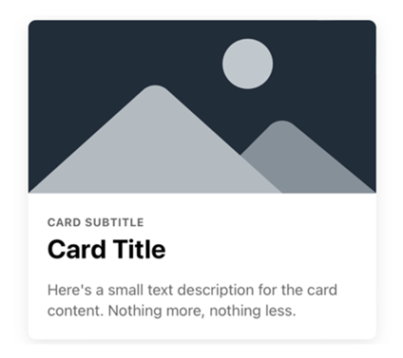
ion-card
Cards are containers that display content such as text, images, buttons, and lists. A card can be a single component, but is often made up of a header, title, subtitle, and content. Cards are broken up into several components to accommodate this structure: card header, card title, card subtitle, and card content.
<ion-card> <img alt="Silhouette of mountains" src="https://ionicframework.com/docs/img/demos/card-media.png" /> <ion-card-header> <ion-card-title>Card Title</ion-card-title> <ion-card-subtitle>Card Subtitle</ion-card-subtitle> </ion-card-header> <ion-card-content> Here's a small text description for the card content. Nothing more, nothing less. </ion-card-content> </ion-card>
Informatics Engineering | Universitas Surabaya

Slide 18
Exercise 2 (max 10 minutes)
Still use Pasta page. Add another pasta display. when card segment is selected, show pastas in cards.
Warning !
You can not use *ngFor and *ngIf in one element.
Informatics Engineering | Universitas Surabaya

Slide 19
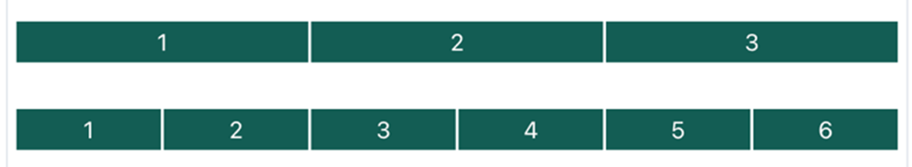
ion-grid
<ion-grid> <ion-row> <ion-col>1</ion-col> <ion-col>2</ion-col> <ion-col>3</ion-col> </ion-row> </ion-grid> <ion-grid> <ion-row> <ion-col>1</ion-col> <ion-col>2</ion-col> <ion-col>3</ion-col> <ion-col>4</ion-col> <ion-col>5</ion-col> <ion-col>6</ion-col> </ion-row> </ion-grid>
The grid is a powerful mobile-first flexbox system for building custom layouts. It is composed of three units — a grid, row(s) and column(s).
Columns will expand to fill the row, and will resize to fit additional columns. It is based on a 12 column layout with different breakpoints based on the screen size. The number of columns can be customized using CSS.
Informatics Engineering | Universitas Surabaya

Slide 20
chunking array
In order to show data in a grid. we need to loop through ion-row and ion-col .
Thus, we need to use 2 dimensional array or we can chunking array from 1 dimensional array.
We will add a function for chunking the array.
add in page.ts
chunkArray(arr: any[], chunkSize: number): any[][] {
const result = [];
for (let i = 0; i < arr.length; i += chunkSize) {
result.push(arr.slice(i, i + chunkSize));
}
return result;
}
Informatics Engineering | Universitas Surabaya

Slide 21
ion-grid (2)
Example: when grid segment is selected, show pastas in grid in 2 columns.
<ion-grid *ngIf="jenistampilan=='grid'">
<ion-row *ngFor="let pastas2 of chunkArray(pastas, 2)" >
<ion-col *ngFor="let pasta of pastas2 " >
<ion-list>
<ion-item>
<ion-img [src]="pasta.url"></ion-img>
</ion-item>
<ion-item>
{{pasta.name}}
</ion-item>
</ion-list>
</ion-col>
</ion-row>
</ion-grid>
Informatics Engineering | Universitas Surabaya

Slide 22
Route with Parameter
Informatics Engineering | Universitas Surabaya

Slide 23
Route with parameter
Routing with parameters allows you to pass data from one page to another when navigating within your app. This is useful for tasks like displaying specific details for an item, searching for content, or customizing the behavior of a page based on user input. Ionic Angular provides a straightforward way to work with route parameters.
const routes: Routes = [
{
path: 'details/:id', // :id is a parameter
loadChildren: () => import('./details/details.module').then(m => m.DetailsPageModule)
},
// Other routes...
];
Informatics Engineering | Universitas Surabaya

Slide 24
Route with parameter (2)
Example, it will open the pastadetail page when user click pasta name or photo in the grid. The click will call a route with parameter. The parameter is the array index. We can get pastas-detail from pastas array with that parameter.
(This time, we will copy pastas data into pastadetail page. Later, we will replace it with Angular Service for sharing data.)
Step :
Create pastadetail page.
Prepare Route with parameter
Prepare code to receive the parameter
Show received parameter ⇒ use simple interpolation binding
Add routerlink with parameter in pasta in grid
If the received parameter is correct , prepare displaying data using this parameter.
Informatics Engineering | Universitas Surabaya

Slide 25
Route with parameter (3)
To get the route parameter, we can use route.params object :
steps:
In page.ts
import { ActivatedRoute } from '@angular/router';
—-----------------------------------------------------------------------------------------------------------------------------------------------------------------
index=0
constructor(private route: ActivatedRoute) {}
ngOnInit() {
this.route.params.subscribe(params => {
this.index = params['index']; // value of 'index' should match the route parameter name
// You can use the 'index' parameter for your logic here
});
}
Informatics Engineering | Universitas Surabaya

Slide 26
Route with parameter (4)
In pasta.page.html
<ion-grid *ngIf="jenistampilan=='grid'">
<ion-row *ngFor="let pastas2 of chunkArray(pastas, 2); let i = index" >
<ion-col *ngFor="let pasta of pastas2; let i2 = index" >
<ion-list>
<ion-item>
<ion-img [src]="pasta.url"></ion-img>
</ion-item>
<ion-item routerLink="/pastadetail/{{(i*2)+i2}}">
{{pasta.name}}
</ion-item>
</ion-list>
</ion-col>
</ion-row>
</ion-grid>
Can you explain why we need this calculation?
Informatics Engineering | Universitas Surabaya

Slide 27
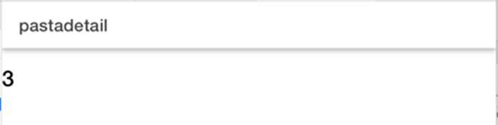
Route with parameter (5)
Check the received parameter !
Informatics Engineering | Universitas Surabaya

Slide 28
Exercise 3 (max 10 minutes)
Fix pastadetail page. Display all data in array pastas, based on received parameter.
Informatics Engineering | Universitas Surabaya

Slide 29
Thanks.
Any Question ?
Informatics Engineering | Universitas Surabaya

